Slide 1
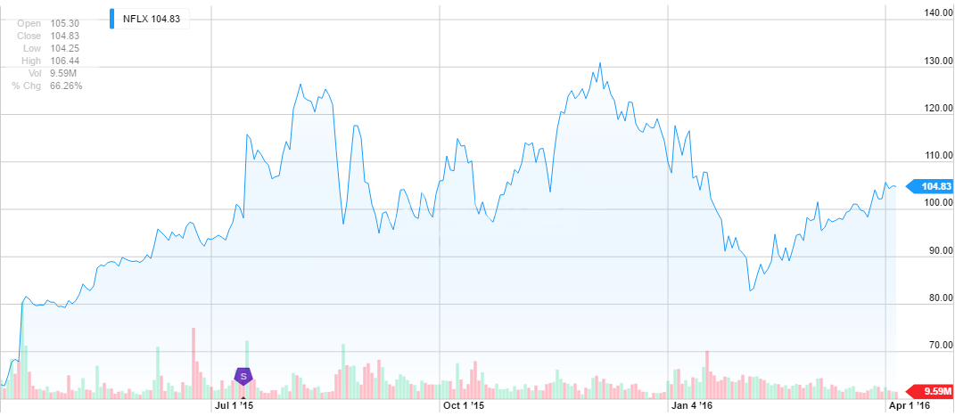
Netflix Inc. (NFLX)
Arman Hastings
April 8th, 2016
Technology Sector

Slide 2

Business Overview
Largest Provider of Streaming Movies and TV series Globally
3,500 employees across United States and Latin America
Headquartered in Los Gatos, California
Maintains over 75 million subscribers
3 Business Segments:
Streaming
Disc Rental
Profiles

Slide 3
Business Overview
Streaming
Most notably is known for their streaming content 7.4 million retail electric customers across 6 states, also sells wholesale to large entities
Allows customers to watch whatever, whenever they please as long as they are on a device that can login to their active account.
This streaming allows customers to watch with no commercials or commitment which improves the viewing experience for customer.
Streaming is accessed amongst many different platforms

Slide 4
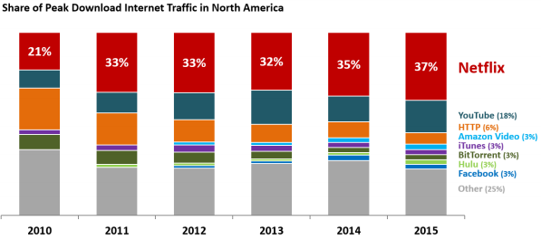
Business Overview
Streaming – Continued
Netflix is the biggest source of North American downstream web-traffic
For web-traffic in North America
- Downstream web-traffic 34.20%
- Aggregate Web-traffic 32.09%
Netflix is also working on increasing their mobile viewers with compromises with cellular companies and their data plans
For mobile use in North America
- Downstream mobile traffic 5.05%
- Aggregate mobile traffic 4.55%

Slide 5
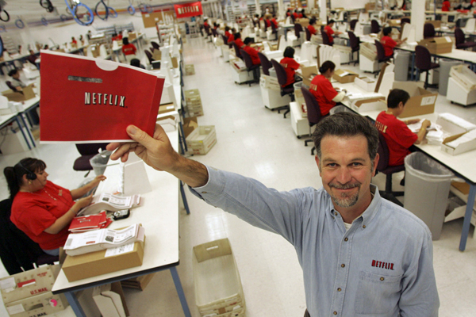
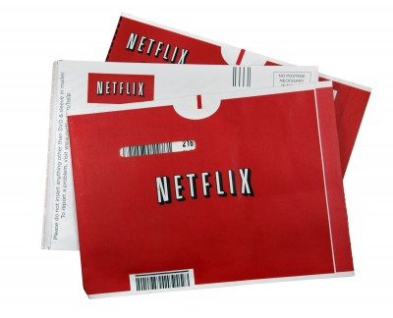
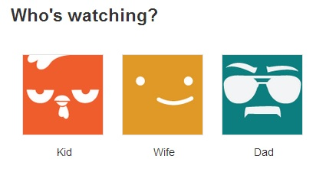
Business Overview
Disc Service
First service offered by Netflix and is still incorporated into Netflix's bundles
Netflix provides this service for a flat fee for the rental of regular and blue-ray discs
Subscribers can upgrade their plans if they see fit
Profiles
Permits accounts to accommodate up to five unique user profiles
This service doesn’t only allow Netflix to more accurately predict what customers want but has also been proven to improve viewers experience

Slide 6

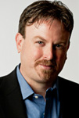



Corporate Governance
Reed Hastings
Co Founder and CEO
David Wells
Chief Financial Officer
Ted Sarandos
Chief Content Officer
Neil Hunt
Chief Product Officer
Kelly Bennett
Chief Marketing Officer
Reed Hastings – Co Foudner & CEO
Serves on the board of Facebook and a number of non profit organizations
Former member of the California State Board of Education
B.S. in Mathematics from Bowdoin College and M.S. in Computer Science from Standford University
ISS Governance Quickscore: Overall Score – 10
Board Structure – 10
Compensation – 9
Shareholder Rights – 10
Audit & Risk Oversight - 2

Slide 7
Competitive Positioning
Currently the largest provider of streaming movies Globally.
Holds the largest share of downstream, and aggregate internet content for North America.
Focus of a one to three ratio of original content to licensed content.
Plan to make specific tailored local content for newly entered regions that are led by local creative experts.
Growth originally created through being the first movers in the space and increased accessibility and content.
Current focus for growth is on long term penetration into foreign entertainment markets.
Increase accessibility to currency, platform, and location as well as creating original content is also a top priority

Slide 8
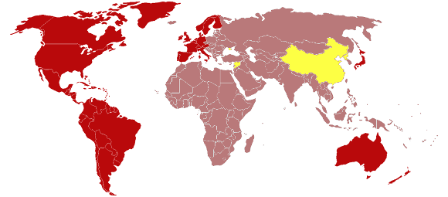
Competitive Positioning
Netflix plans to cover the globe in streaming services by the end of 2016
Plan to move into the Asian Tiger nations of Hong Kong, Taiwan, South Korea, and Singapore for early 2016
Netflix also plans to move into China but is not rushing the situation as there is some clearance needed to enter. In the meantime Netflix will focus on its currently and recently entered countries.
The dark red areas are where Netflix currently serves. However they still aim to other yellow markets such as china as soon as they receive clearance to do so.

Slide 9
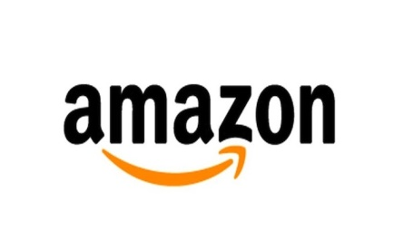





Competitive Environment
Amazon.com (AMZN)
Based in Seattle, WA
Market Cap: $15.18 billion
Largest Internet-based retailer in the United States. Started to diversify into selling DVD’s, Blu-rays, and video downloads/streaming
Outerwall (OUTR)
Based in Bellevue, WA
Market Cap: $1.24 billion
Owns RedBox and is focusing more on their network of movie and video game rental kiosks
Viacom (VIAB)
Based in Manhattan, NY
Market Cap: $15.66 billion.
Mass media company comprised of BET Networks, Viacom Media, and paramount Pictures
Disney (DIS)
Based in Burbank, CA
Market Cap: $161 billion
Diversified multinational mass media and entertainment conglomerate
Time Warner Cable (TMX)
Based in Midtown Manhattan, NY
Market Cap: $55.32 billion
Second largest American cable telecommunications company.

Slide 10
SWOT Analysis
Strengths
Development of more Netflix original content both to local and global markets.
Massive North American popularity .
User experience and ease of access in comparison to linear TV content or tradition rental stores.
Very competitive “sweet spot”, as described by management, price points.
Weaknesses
High prices for mobile data plans
Pricing power, and various movies and studios asking for a “28-day window”
Terms of content distribution are not exclusive
Censorship for countries that ask for it.
Opportunities
Growth in global markets
Creating and expansion on kids programming that is created for both kids, and parents.
T-mobile “Binge on!”, and Verizon's “Freebie!” initiatives to allow mobile customers watch shows and movies for free up until a limit.
Threats
Foreign currency exchange rates are slowing growth in their new countries and eating into their net income.
Net Neutrality risks; Changes or abuse
Other companies offering streaming services such as Amazon or Hulu.

Slide 11
Current Events
Netflix Cracks down against VPNs; Feb. 29, 2016
To help Netflix prevent customers from watching video that isn't licensed for viewing in their country.
Netflix is Now Available Around the World; Jan. 6, 2016
Ringing its Internet TV network to more than 130 new countries around the world
Netflix Brings Their First New Original Anime Series, “Perfect Bones”, to Member Worldwide; Feb. 26, 2016
Will be the first ever original Anime title to debut all episodes simultaneously in 190 countries
Netflix added Arabic, Korean, Simplified and Traditional Chinese to the 17 languages it already supports
Netflix to Announce First-Quarter 2016 Financial Results, Available Apr. 18; Mar. 16, 2016
Netflix’s 2016 First-Quarter will be available April 18

Slide 12
Financial Performance
Revenue from 2010 - 2015
Historically, revenue has grown at an average of 26% year over year for the last 5 years
EPS decreased dramatically in 2012 due to Netflix's investments global expansion
CAPEX increased 55.3% in 2015 due to increased investment in infrastructure and maintenance costs
Amounts in USD thousands

Slide 13
Financial Performance
Revenue from 2010 - 2015
Assets and liabilities are growing at similar rates
The large jump in both in the 2011 year can bring some insight to some anomalies within the spread sheets
The steady increase in assets and cash equivalents will also provide a solid base for Netflix as they build their services up in other countries
Amounts in USD thousands

Slide 14
Valuation: DCF (50%)
Assumptions:
Revenue: 26%-38% year over year projected growth. Fair for stage one and two but optimistic for stage 3 when compared to other analysts estimates of 26%-29%.
Cost of Capital: currently at 10.92% which is fair for the grow Netflix is wanting to do
Values tend to jump in stage three for the estimated massive growth they should receive once they have grew into more countries, solved accessibility issues and have created a fan base with their original content that is exclusive to that area.
2017 will also be around the time where Netflix will be able to get into and establish a solid foundation in China.
Calculated Value per Share: $122.94

Slide 15
Valuation: Relative (15%)
5 Companies were used in relative analysis
Chosen due to similar business strategies/market capitalization
Amazon
Outerwall
Time Warner
Disney
Viacom
P/E, PEG, P/S, P/BV, and EV/EBITDA were used to value the comparable companies with NFLX.
PEG calculation was slightly off due to the fact that Outerwall’s PEG currently lacks one.
Current Price: $104.94
Calculated Value per Share: $105.76

Slide 16
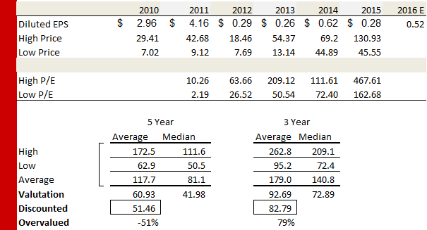
Valuation: Historical (15%)
Assumptions
Only 3 year and 5 year averages used
High EPS before 2012 does not reflect reasonable current or future estimates
2016 E EPS used was calculated from the DCF Model
Current Price: $104.94
3-Year Discounted Valuation: $51.46
5-Year Discounted Valuation: $82.79

Slide 17
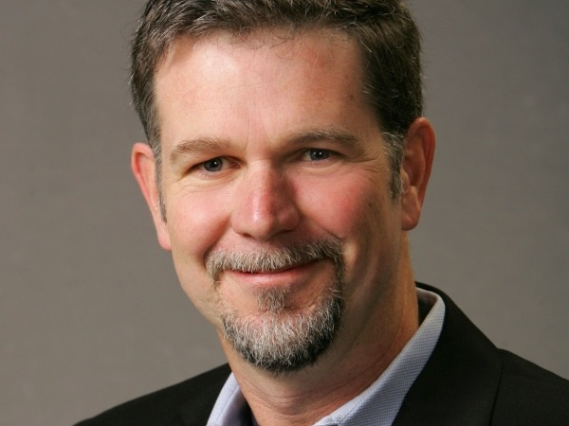
Recommendation
BUY
Intrinsic Value per Share: $115.82
Current Price Per Share: $104.94
Margin of Safety: 8.95%
Questions?

